Slide 1
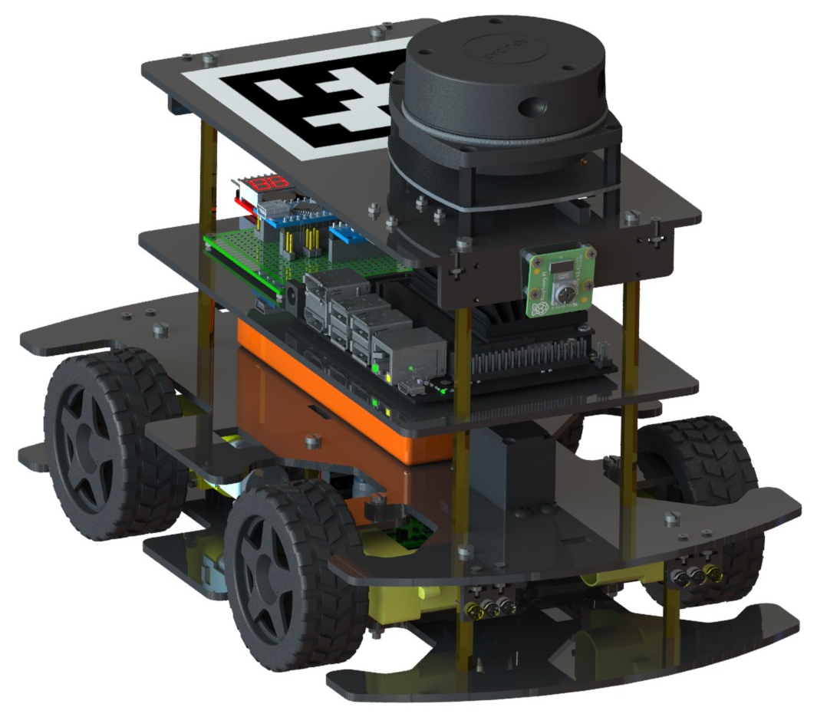

Slide 2
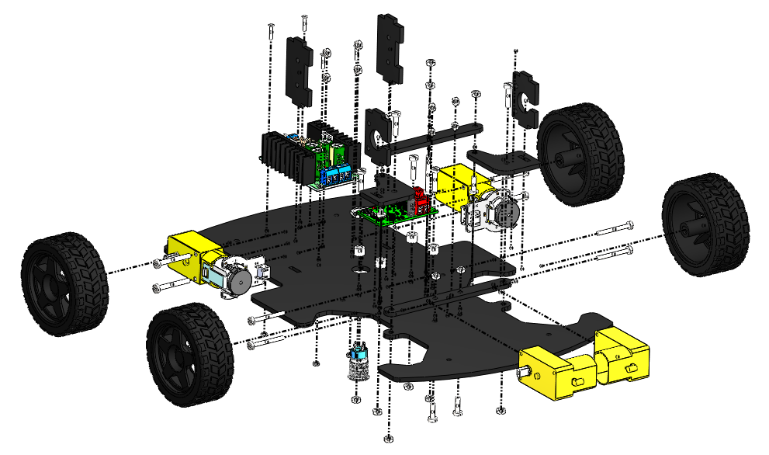
7
6
9
8
5
3
2
1
10
4
12
11

Slide 3
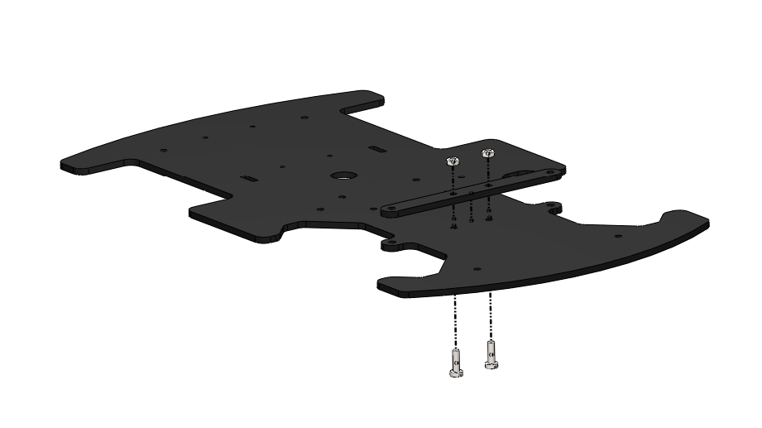
M3 NUT
M3 x 10 BOLT

Slide 4
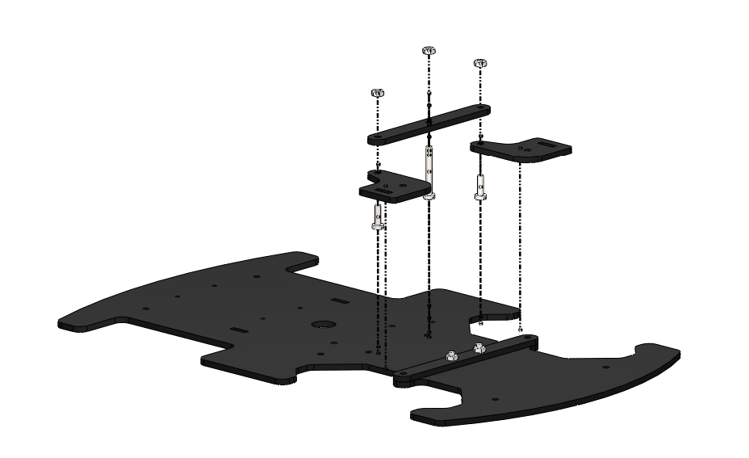
M3 NUT
M3 x 25 BOLT
M3 x 10 BOLT
M3 x 10 BOLT

Slide 5
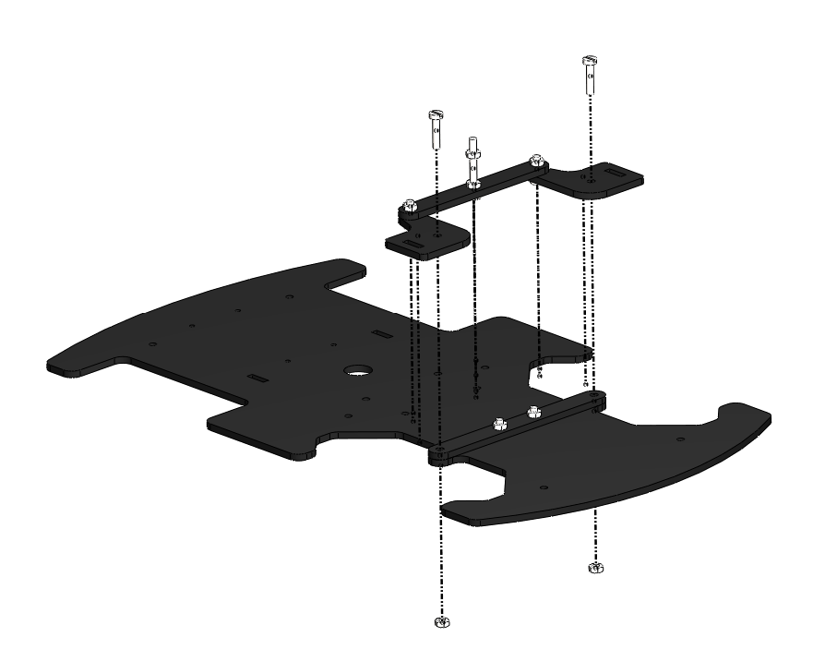
M3 x 14 BOLT
M3 NUT

Slide 6
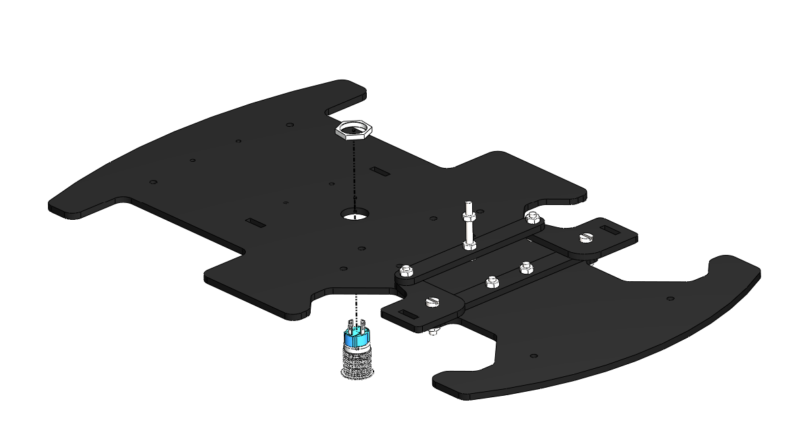
THE SWITCH IS INSERTED INTO THE SLOT FROM BELOW, THEN THE NUT IS TWISTED IN PLACE FROM ABOVE

Slide 7
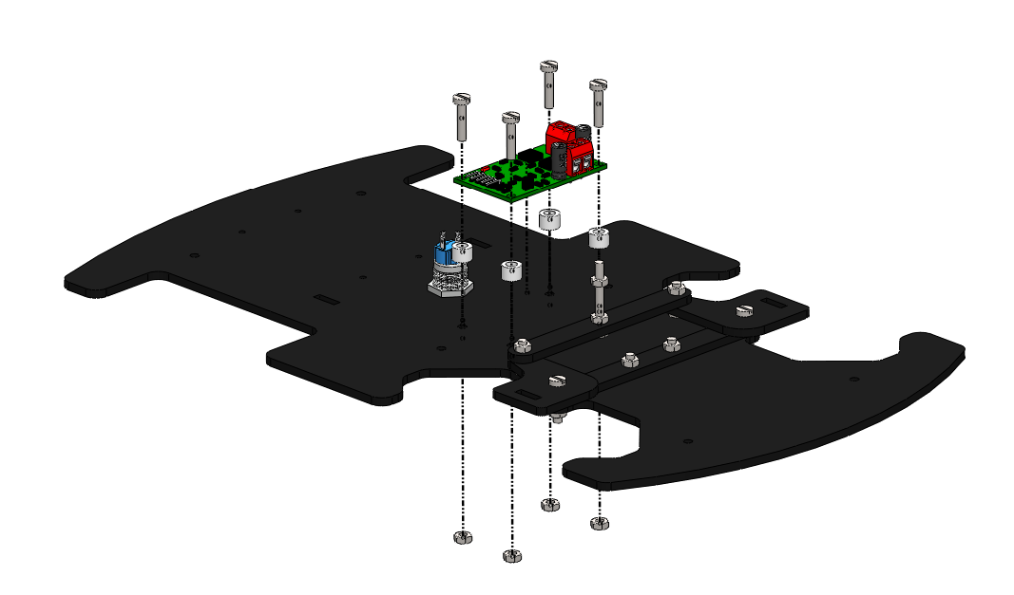
M3 x 14 BOLT
M4 x 5 SPACER
M3 NUT

Slide 8
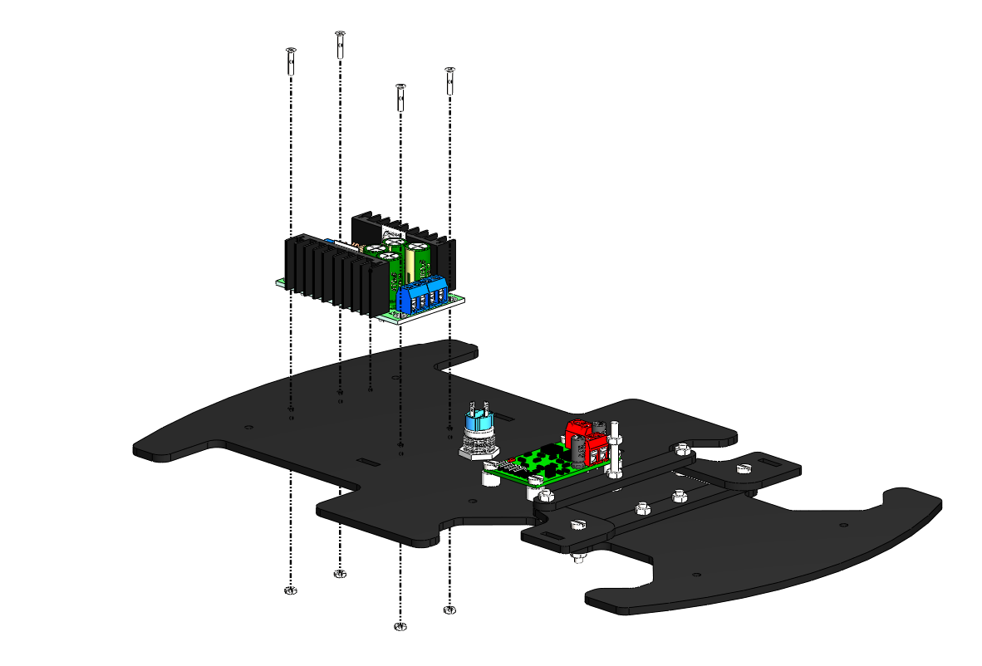
M2 x 10 BOLT
M2 NUT

Slide 9
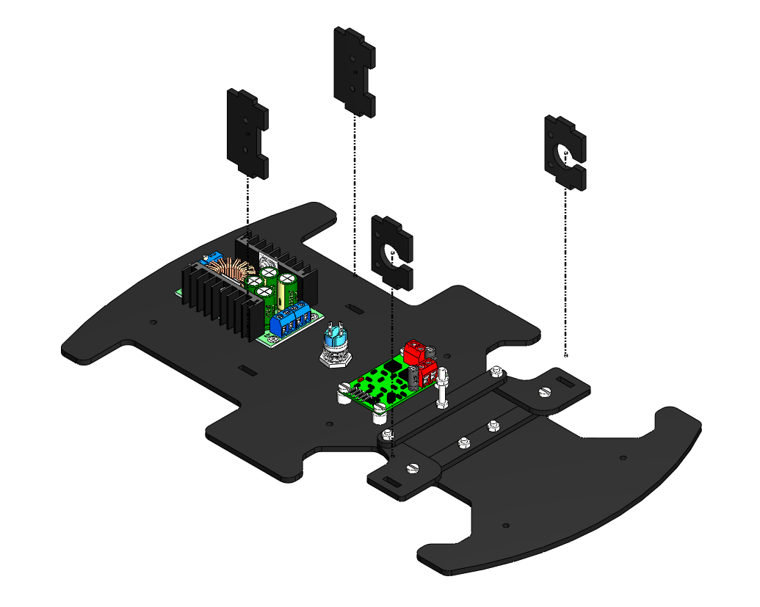
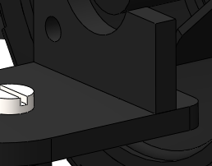
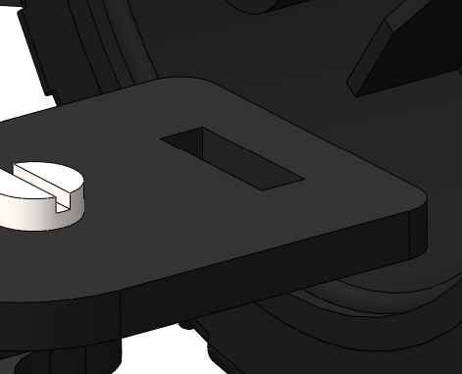
AFTER
BEFORE
THE MOTOR MOUNT IS INSERTED INTO THE SLOT IN THE STEERING KNUCKLE

Slide 10
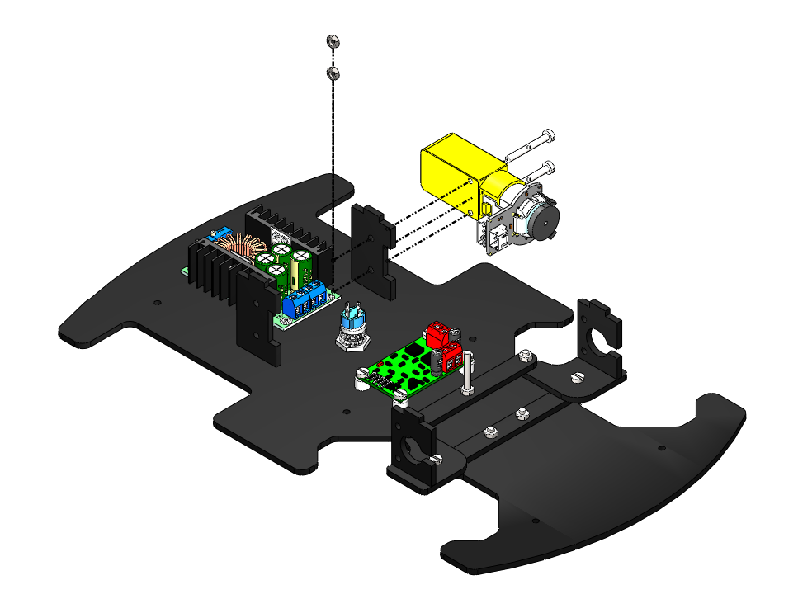
M3 NUT
M3 X 25 BOLT

Slide 11
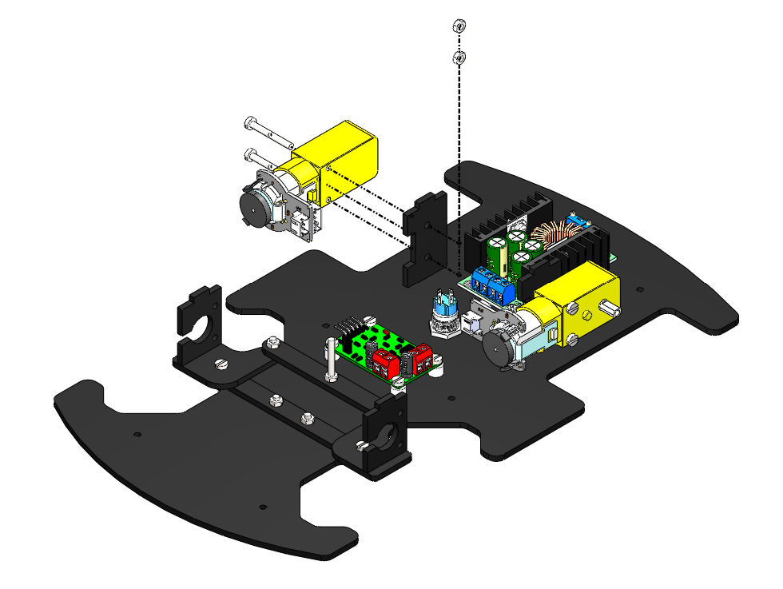
M3 X 25 BOLT
M3 NUT

Slide 12
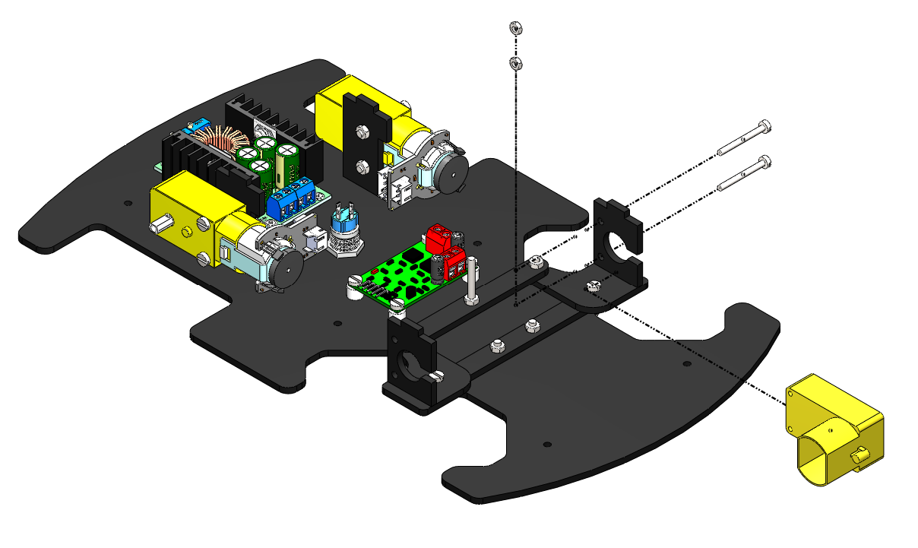
M2.5 NUT
M2.5 x 25 BOLT

Slide 13
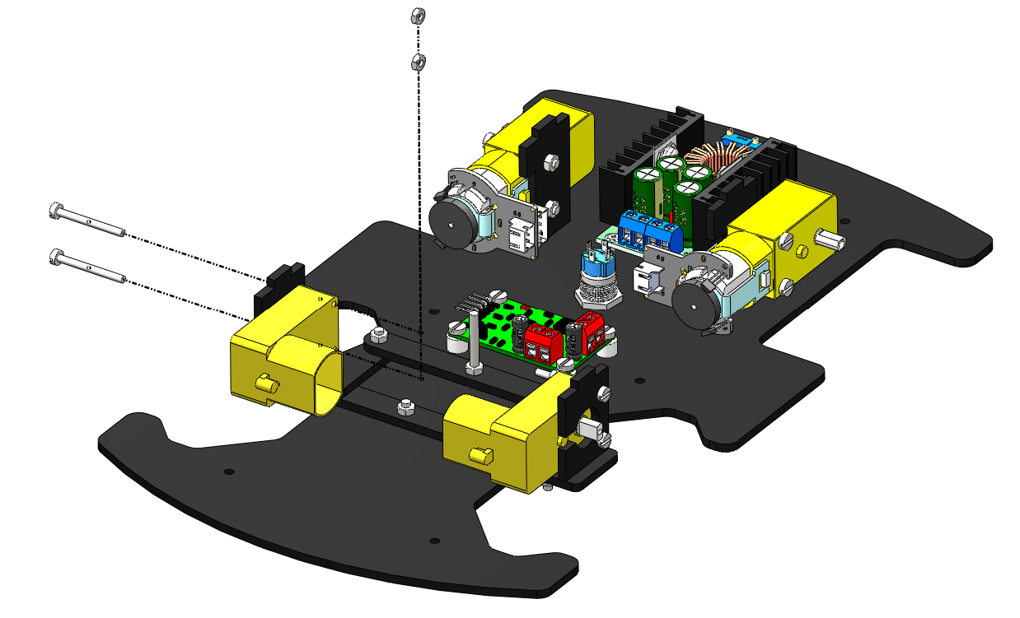
M2.5 NUT
M2.5 x 25 BOLT

Slide 14
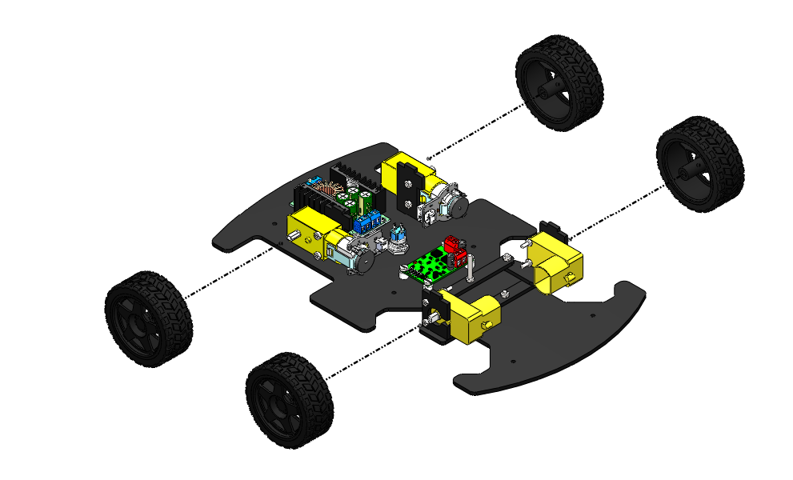
WHEEL PRESS FIT INTO THE MOTOR SHAFT

Slide 15
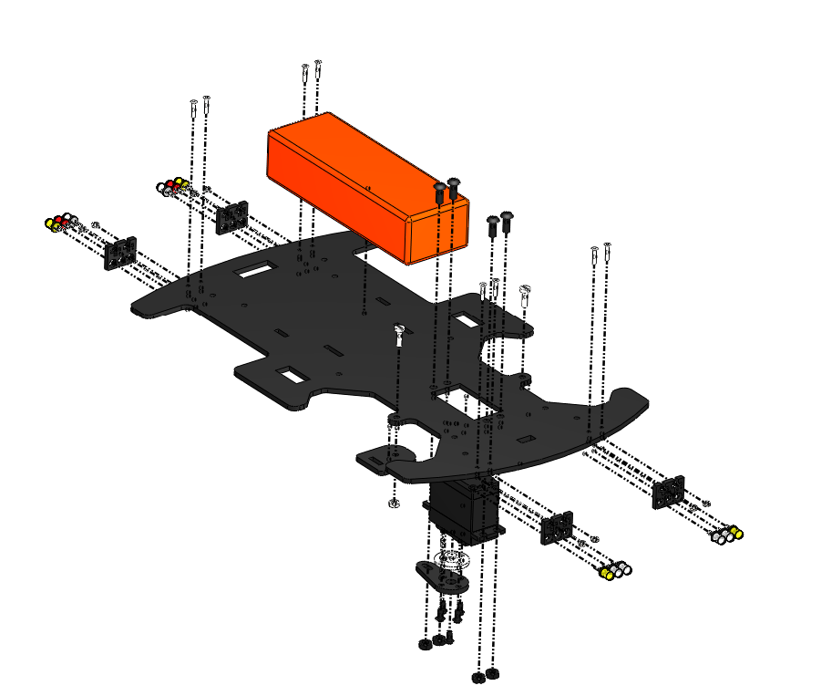
3
6
5
2
7
4
1

Slide 16
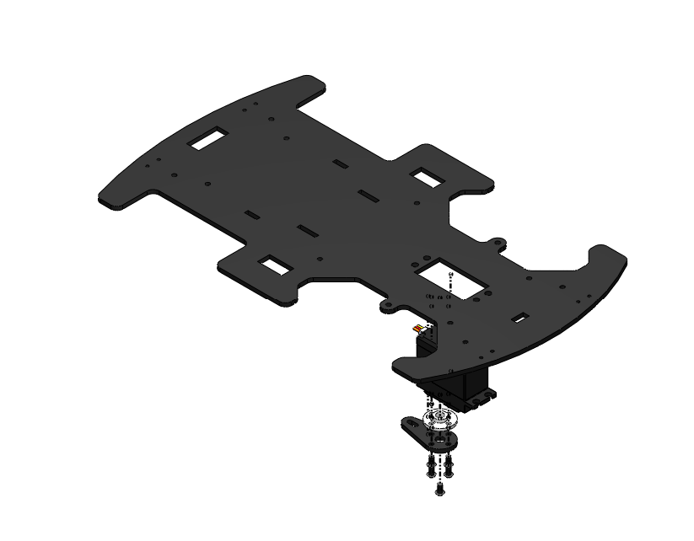
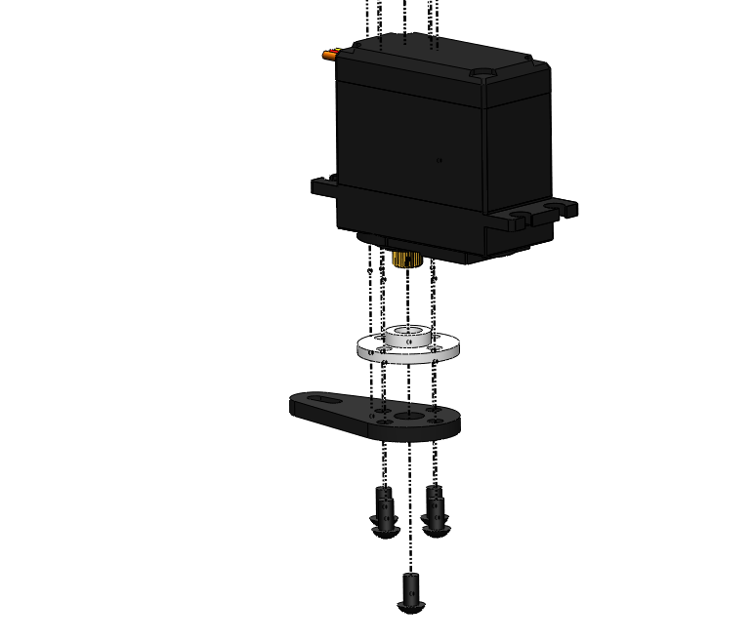

MOTOR TOP FACE MATES WITH BOTTOM FACE OF THE PLATFORM
M3 x 6 BOLT

Slide 17
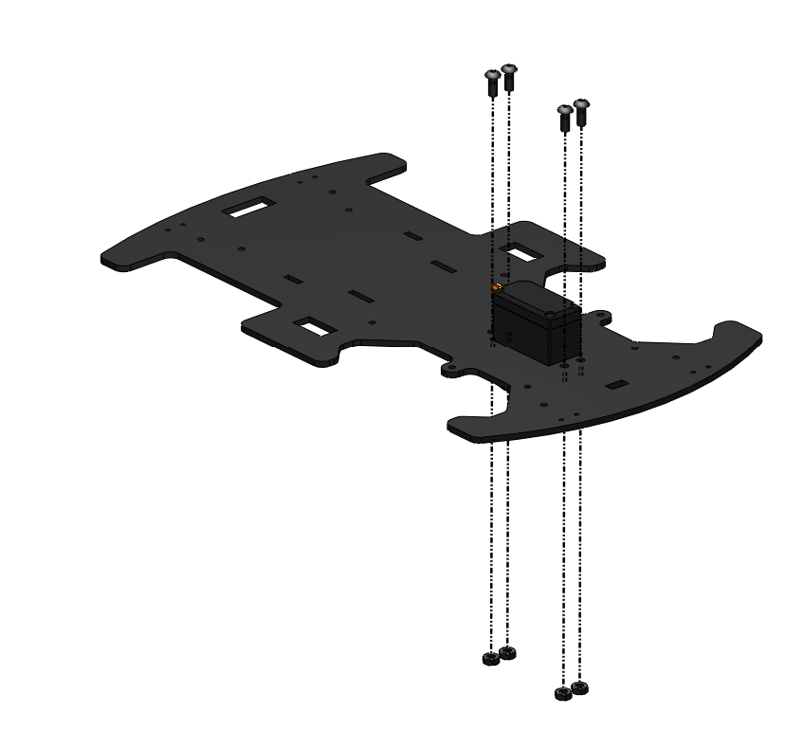

M4 x 10 BOLT
M4 NUT

Slide 18
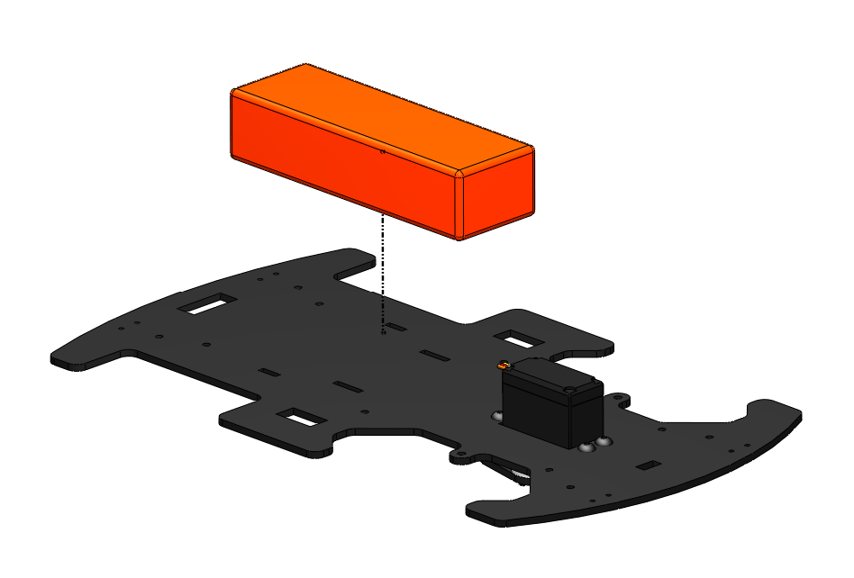
BATTERY STRAP SLOTS
BATTERY STRAP SLOTS

Slide 19
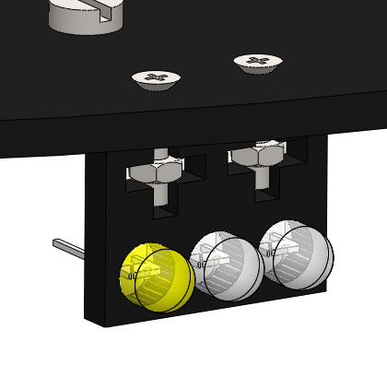
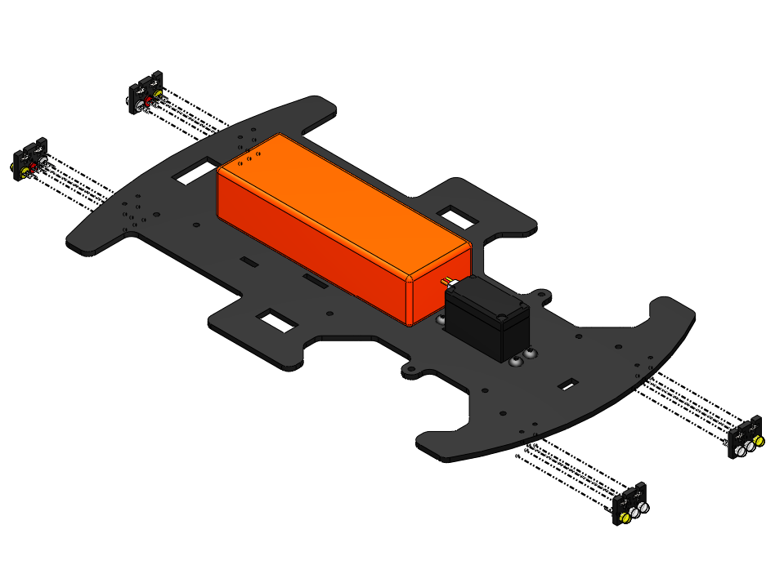
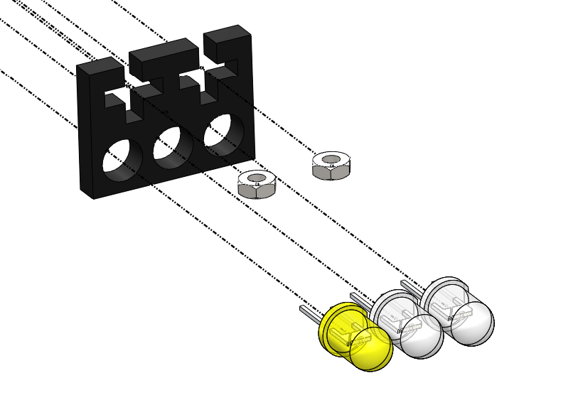
M2 NUT

Slide 20
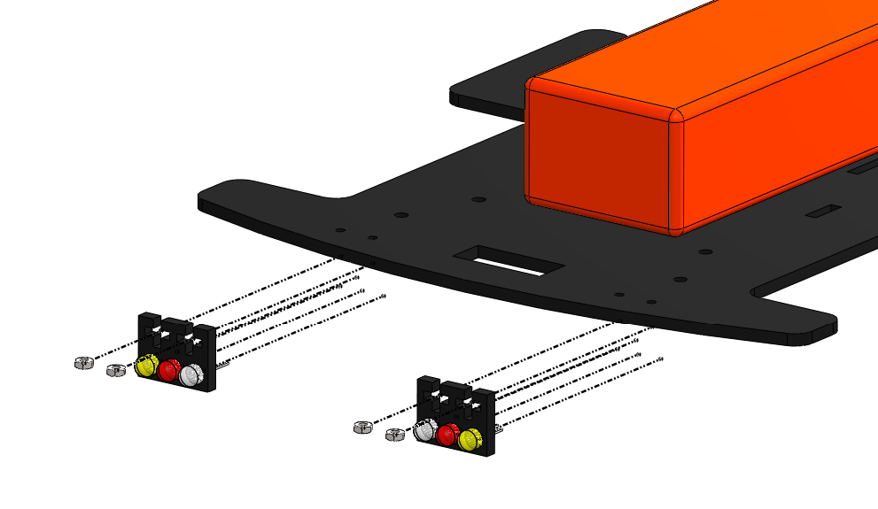
M2 NUT

Slide 21
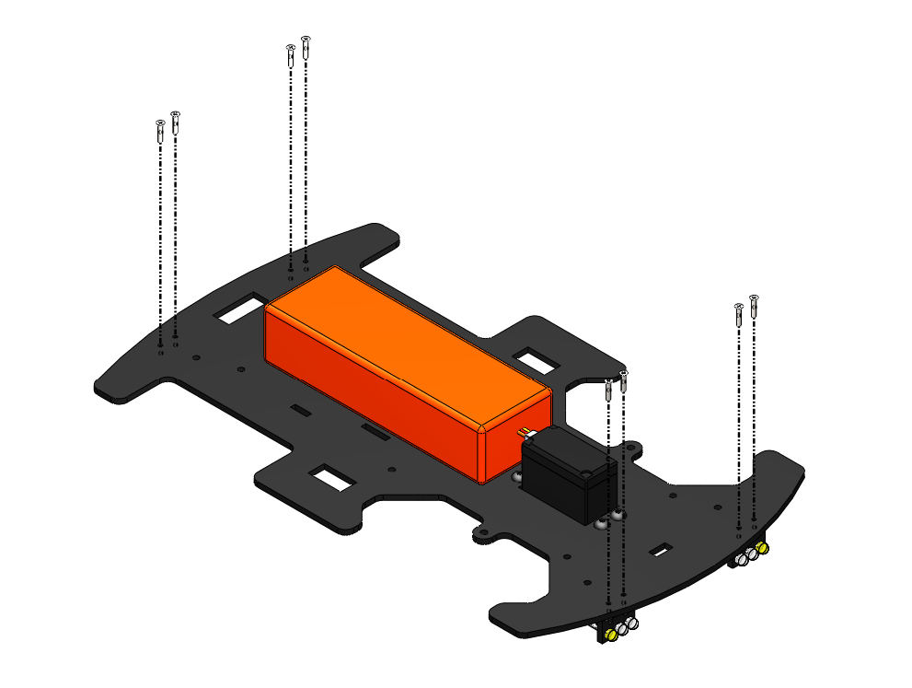
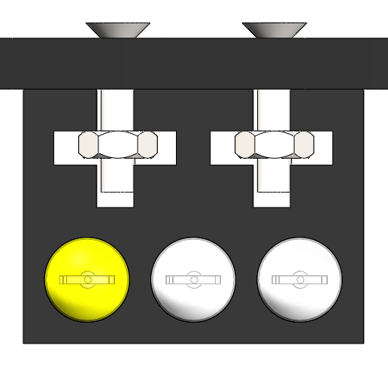
M2 x 10 BOLT

Slide 22
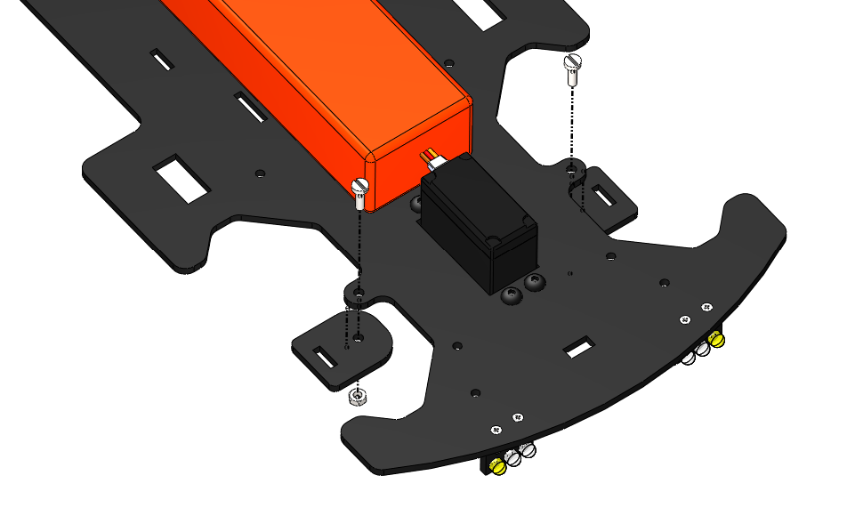
M3 X 10 BOLT
M3 NUT

Slide 23
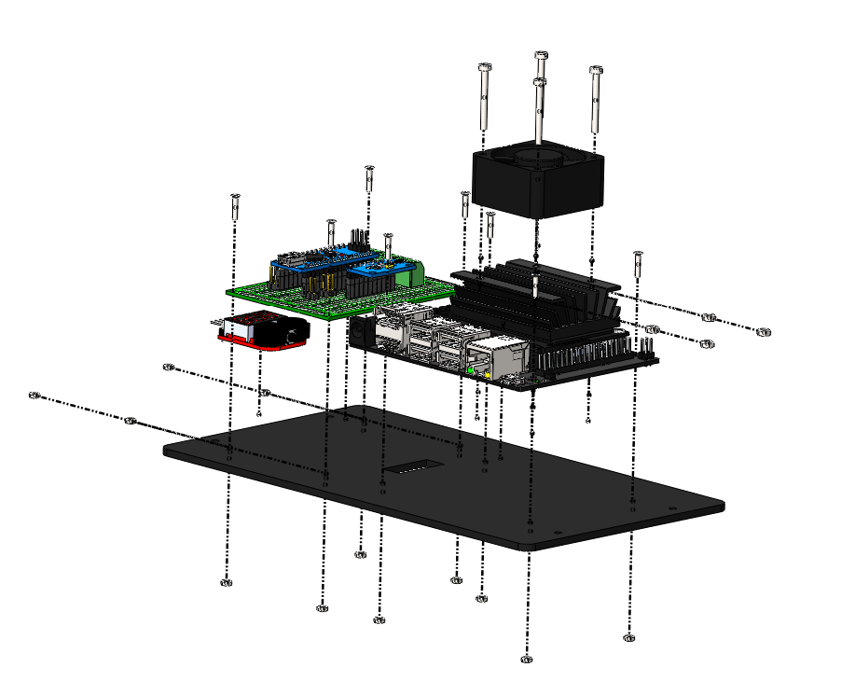
1
3
4
2

Slide 24
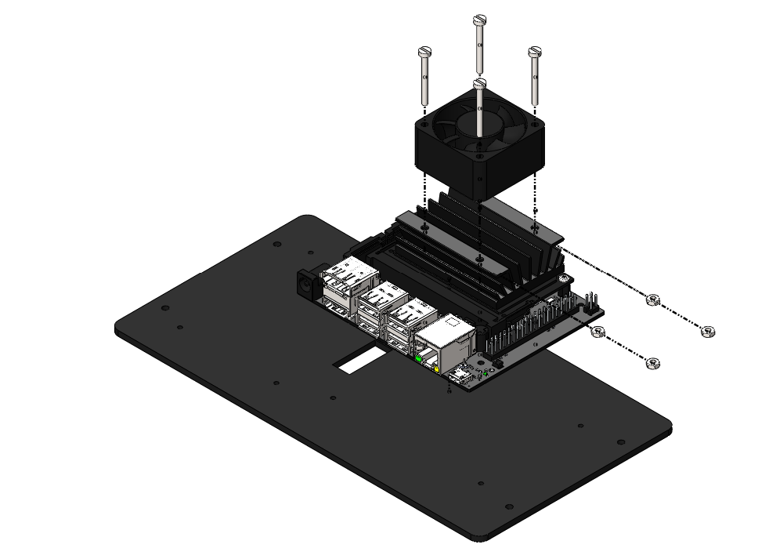
M2.5 x 25 BOLT
M2.5 NUT

Slide 25
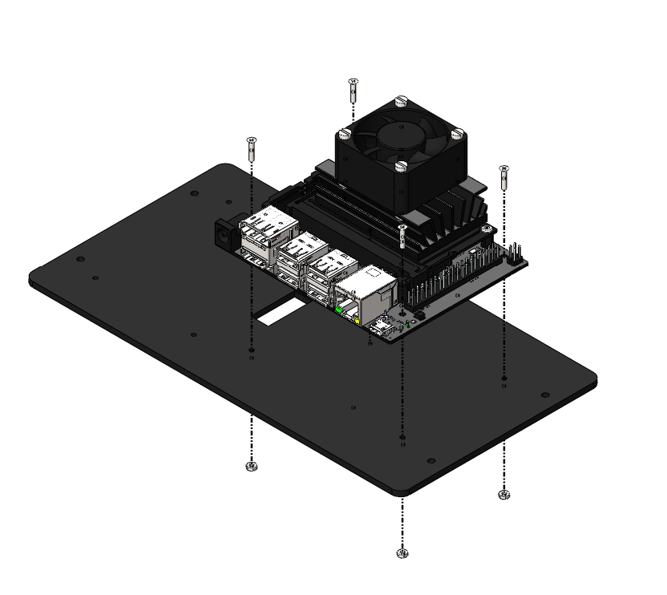
M2 x 10 BOLT
M2 NUT

Slide 26
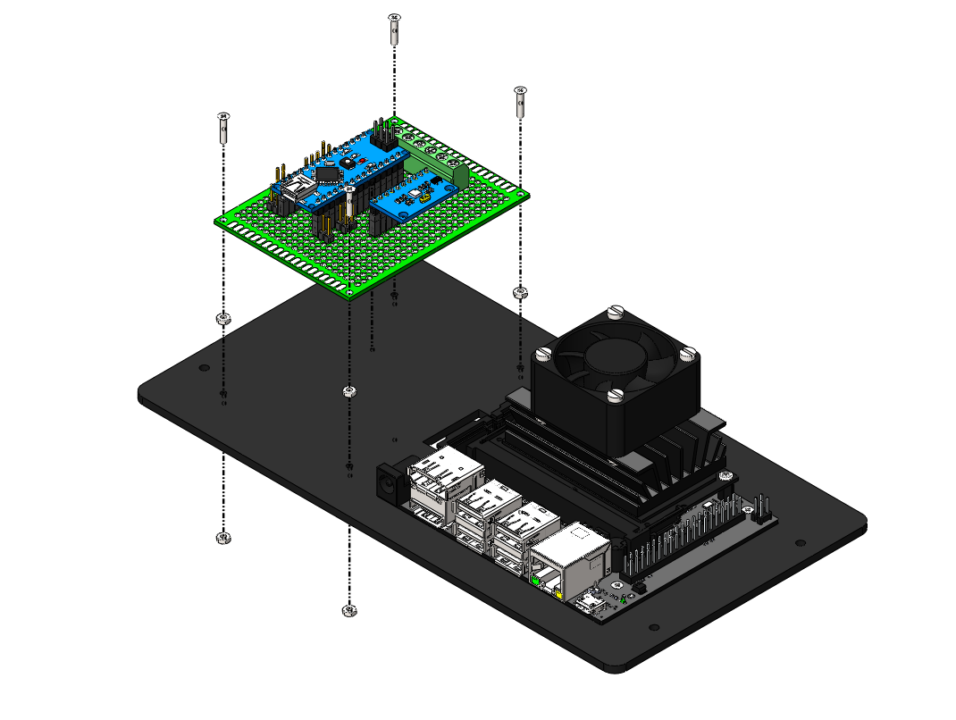
M2 x 10 BOLT
M2 NUT AS A SPACER
M2 NUT

Slide 27
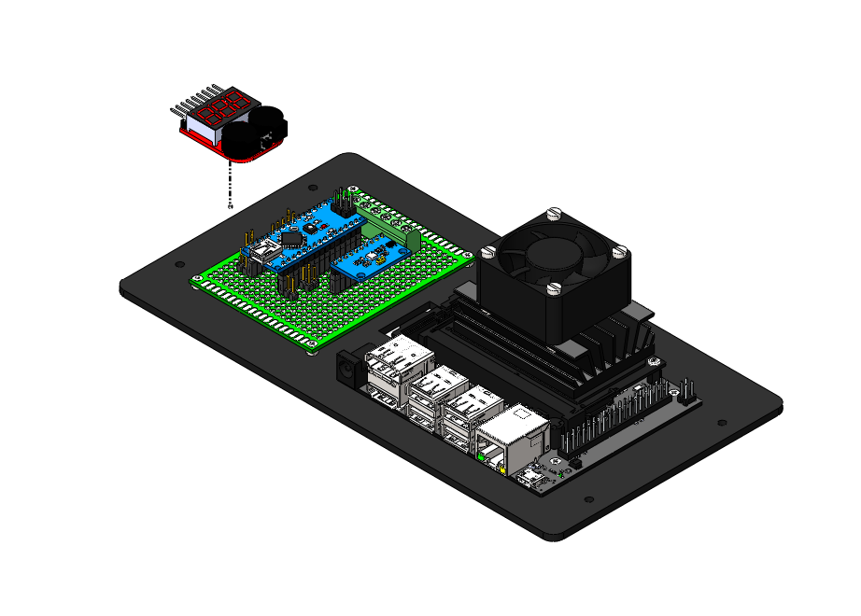
DOUBLE SIDED TAPE

Slide 28
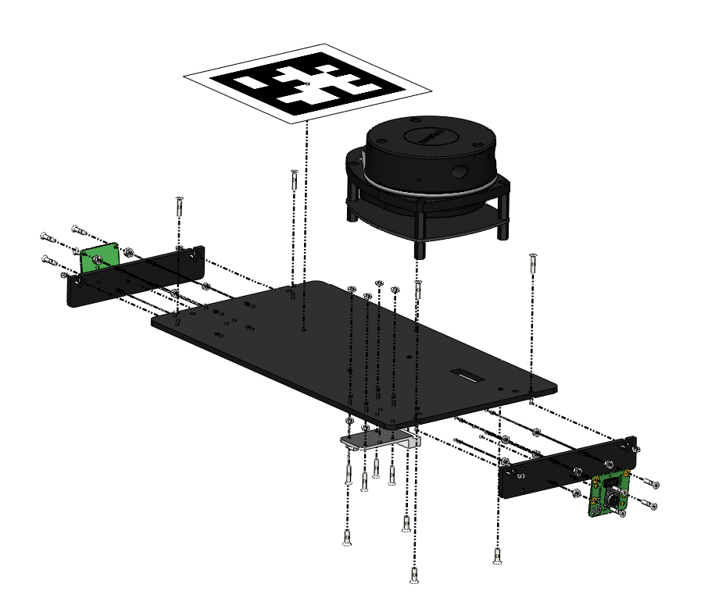
5
4
2
3
1

Slide 29
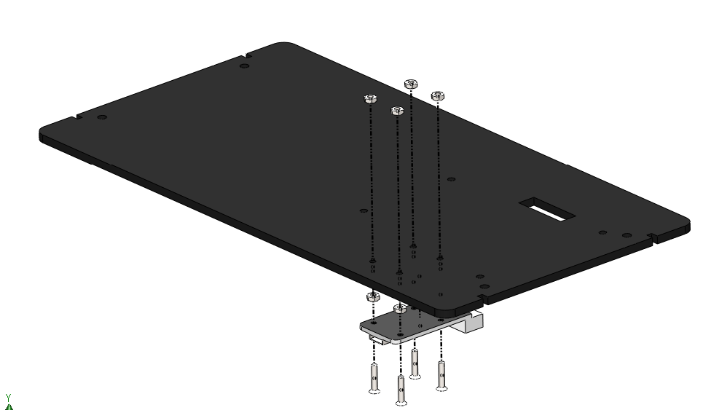
M2 NUT
M2 NUT AS A SPACER
M2 x 10 BOLT

Slide 30
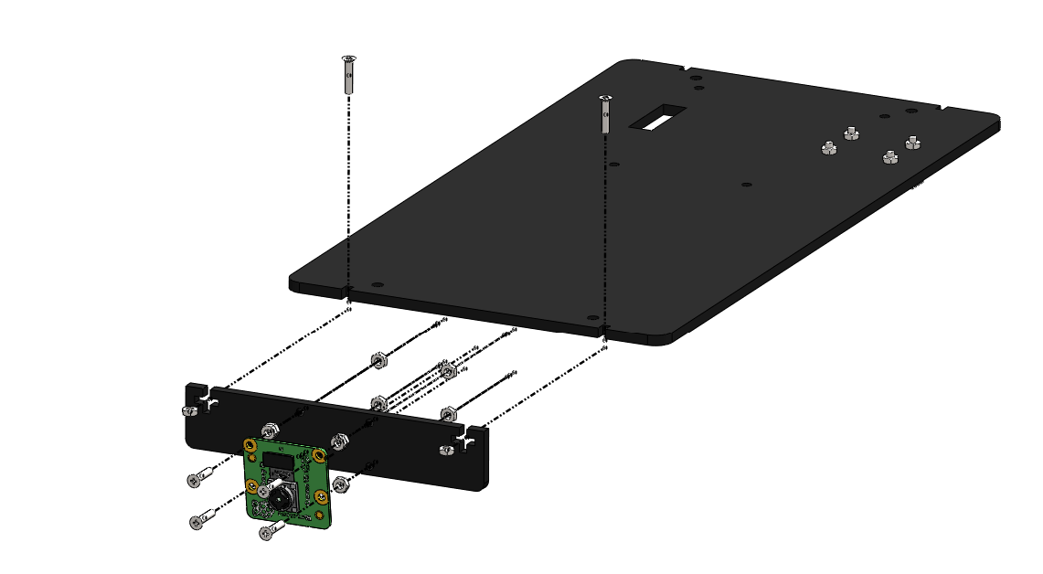
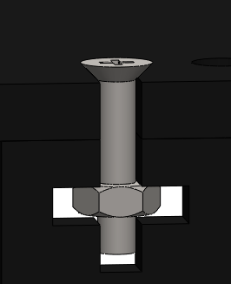
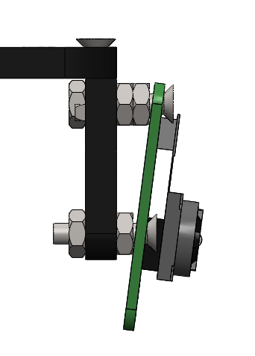
M2 x 10 BOLT
2 NUTS ON TOP
M2 NUT
M2 NUT
M2 x 10 BOLT
SIDE VIEW

Slide 31
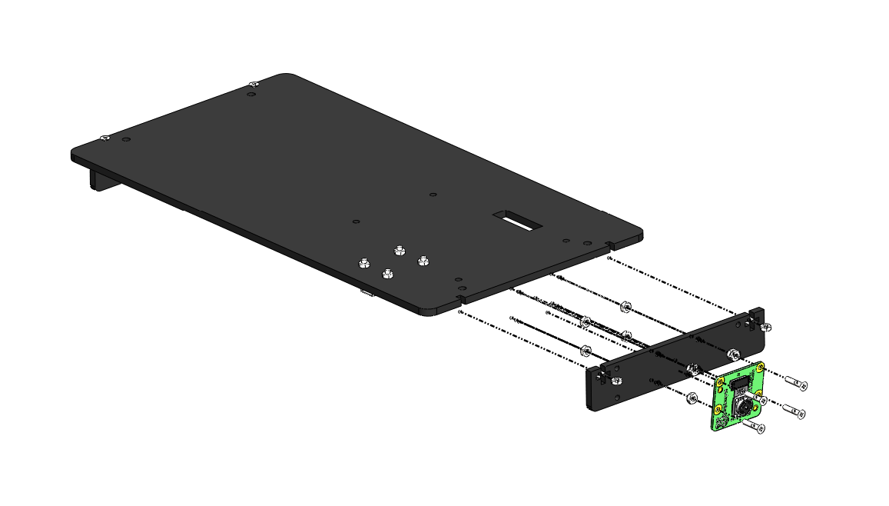
M2 NUT
M2 x 10 BOLT

Slide 32
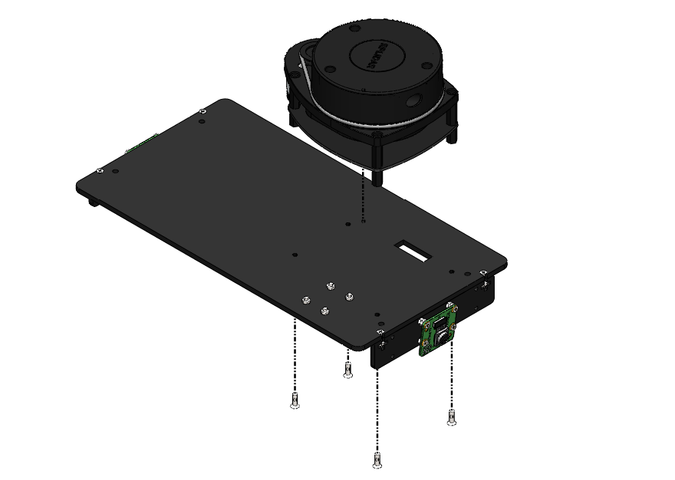
M2.5 x 8 BOLT

Slide 33
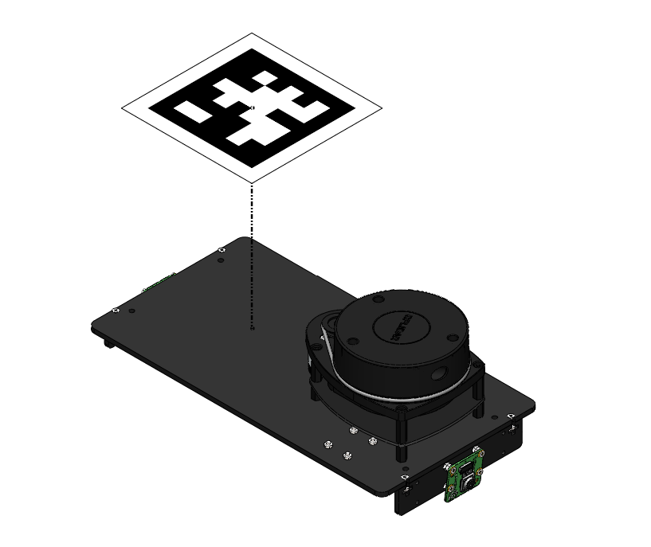
APRILTAG IS PASTED ON

Slide 34
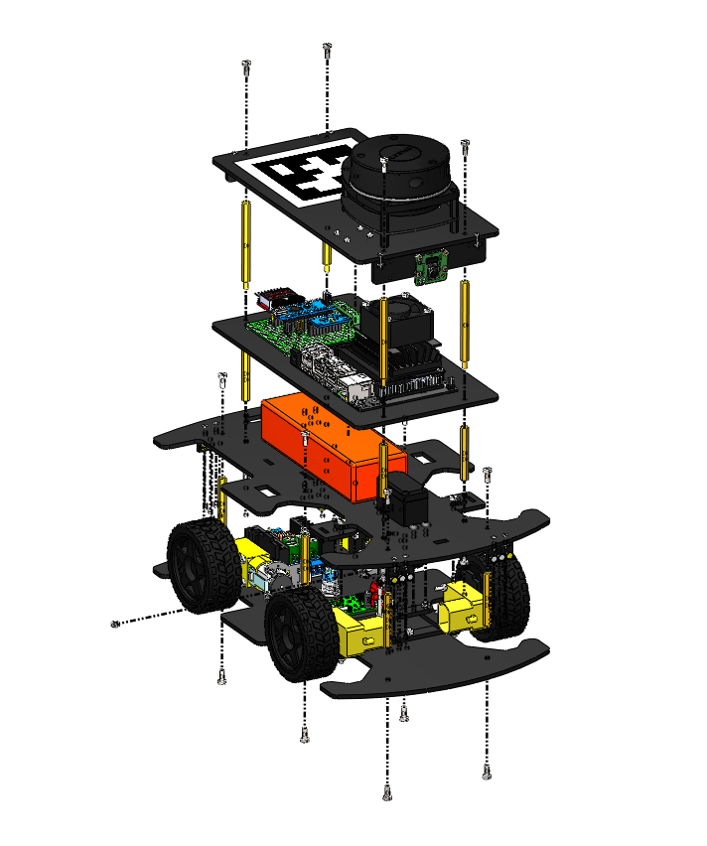
6
5
2
4
3
1

Slide 35
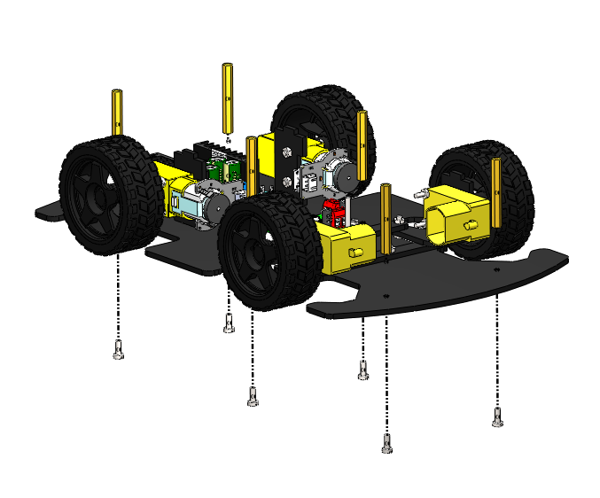
M3 x 40 F-F STANDOFF
M3 x 8 BOLT

Slide 36
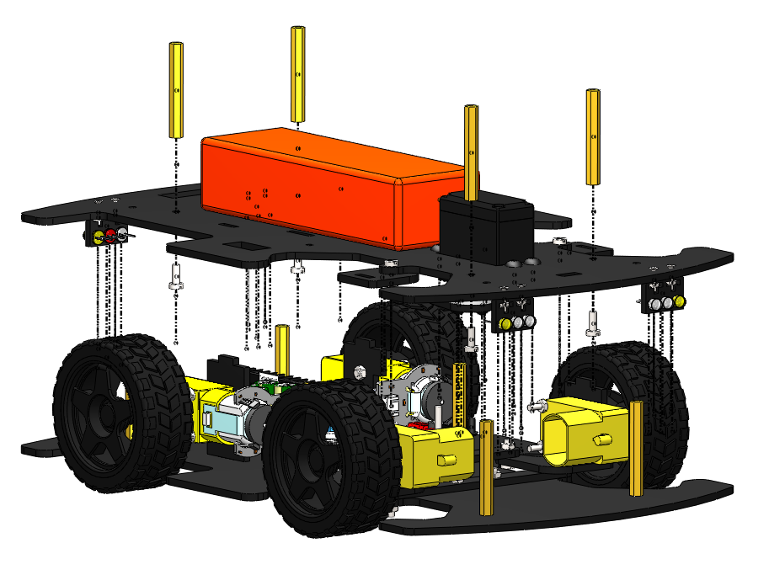
M3 x 40 F-F STANDOFF
M3 x 8 BOLT

Slide 37
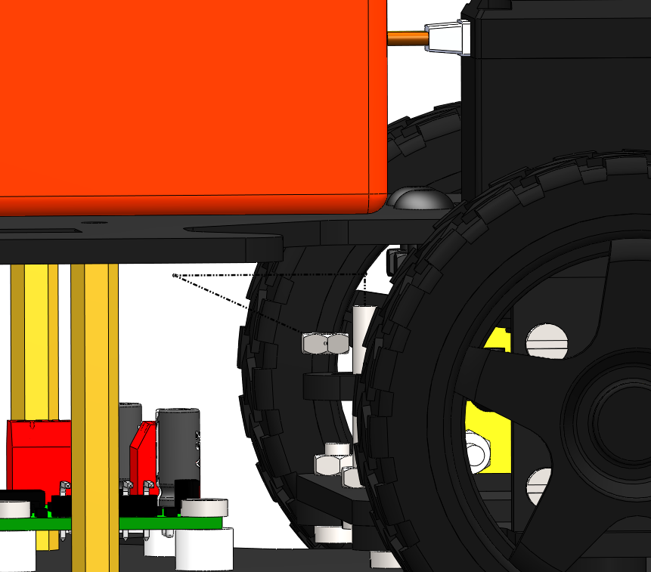
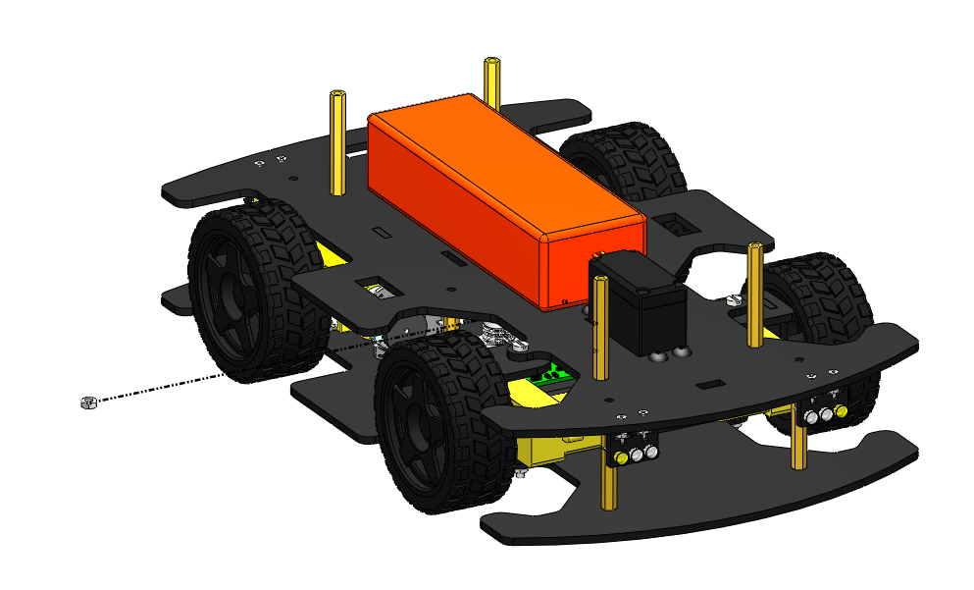
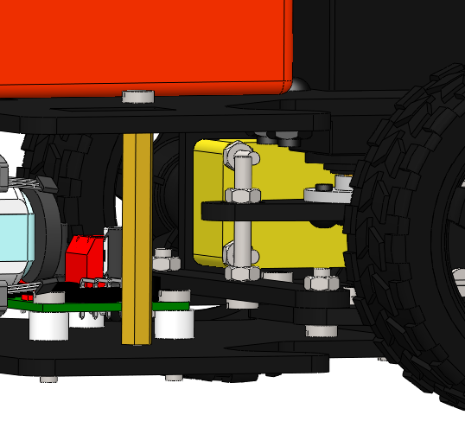
M3 NUT

Slide 38
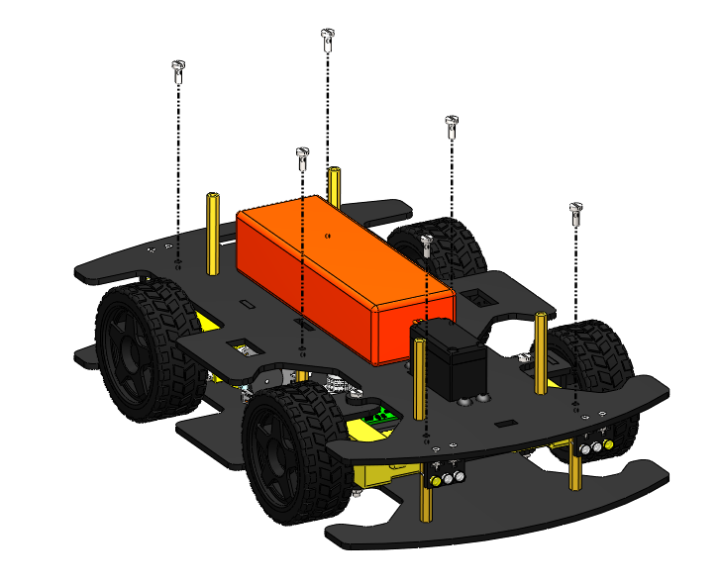
M3 x 8 BOLT

Slide 39
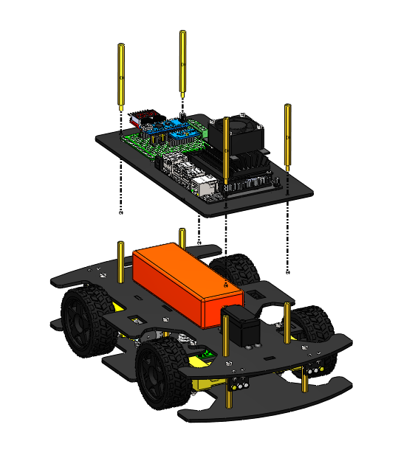
FEMALE SIDE
M3 x 60 M-F STANDOFF
MALE SIDE

Slide 40
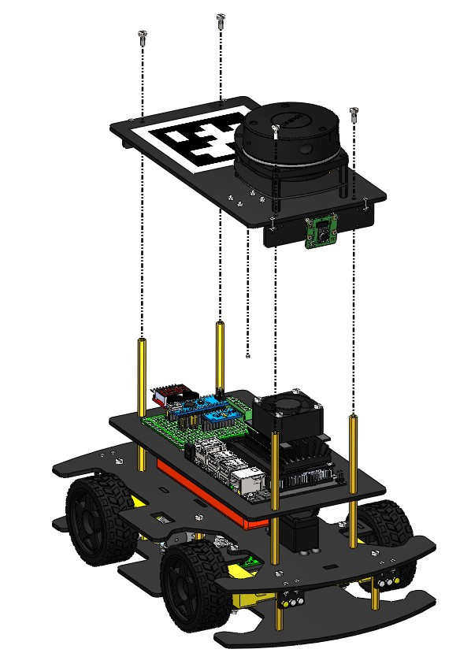
M3 X 8 BOLT

